Slide 1
Announcements
My name: Prof. Abhradeep Guha Thakurta (You can call me Prof. Thakurta)
Course staff:
Andrei Ignat
Joseph Mazeika
Lena Reed
Bhumika Gupta

Slide 2
Announcements
Policies for the class:
Use of any technology (including cellphone and laptops) is strongly discouraged
The class webpage is hosted on Canvas: https://canvas.ucsc.edu/courses/258 . We will try not to use Piazza unless Canvas becomes unbearable ☺
For any discrepancy with grades, your first point of contact are the TAs. They know the grading rubric the best.
No email policy regarding grades: If you have any discrepancy with the grades, come to the office hours. We (including the TAs) will not answer grading questions over email.

Slide 3
Announcements
Discussion section this week:
No discussion section today (4/3/2017)
Sections on Tuesday, Wednesday, Thursday and Friday this week will be held at regular times.

Slide 4


Chapter 1
Introduction:
Some Representative
Problems
Slides by Kevin Wayne.
Copyright © 2005 Pearson-Addison Wesley.
All rights reserved.
Notes:
Please report any errors to Kevin Wayne (wayne@cs.princeton.edu). Thanks!

Slide 5
1.1 A First Problem: Stable Matching

Slide 6
Matching Residents to Hospitals
Goal. Given a set of preferences among hospitals and medical school students, design a self-reinforcing admissions process.
Unstable pair: applicant x and hospital y are unstable if:
  x prefers y to its assigned hospital.
  y prefers x to one of its admitted students.
Stable assignment. Assignment with no unstable pairs.
  Natural and desirable condition.
  Individual self-interest will prevent any applicant/hospital deal from being made.

Slide 7
Stable Matching Problem
Goal. Given n men and n women, find a "suitable" matching.
  Participants rate members of opposite sex.
  Each man lists women in order of preference from best to worst.
  Each woman lists men in order of preference from best to worst.
favorite
least favorite
favorite
least favorite
1st
2nd
3rd
1st
2nd
3rd
Xavier
Amy
Bertha
Clare
Amy
Yancey
Xavier
Zeus
Yancey
Bertha
Amy
Clare
Bertha
Xavier
Yancey
Zeus
Zeus
Amy
Bertha
Clare
Clare
Xavier
Yancey
Zeus
Men’s Preference Profile
Women’s Preference Profile
Notes:
med school admissions has some distracting asymmetries: each college looking for several applicants, but each student looking for one college; there may be more (fewer) applicants than available slots for colleges; each student does not apply to every college
"bare-bones" version of the problem; also a change of scenery
preserves essential nature of problem; in particular our solution to this simplified version extends to more general case

Slide 8
Stable Matching Problem
Perfect matching: everyone is matched monogamously.
  Each man gets exactly one woman.
  Each woman gets exactly one man.
Stability: no incentive for some pair of participants to undermine assignment by joint action.
  In matching M, an unmatched pair m-w is unstable if man m and woman w prefer each other to current partners.
  Unstable pair m-w could each improve by eloping.
Stable matching: perfect matching with no unstable pairs.
Stable matching problem. Given the preference lists of n men and n women, find a stable matching if one exists.

Slide 9
Stable Matching Problem
Q. Is assignment X-C, Y-B, Z-A stable?
favorite
least favorite
favorite
least favorite
1st
2nd
3rd
1st
2nd
3rd
Xavier
Amy
Bertha
Clare
Amy
Yancey
Xavier
Zeus
Yancey
Bertha
Amy
Clare
Bertha
Xavier
Yancey
Zeus
Zeus
Amy
Bertha
Clare
Clare
Xavier
Yancey
Zeus
Men’s Preference Profile
Women’s Preference Profile
Notes:
Bertha and Xavier will pair up

Slide 10
Stable Matching Problem
Q. Is assignment X-C, Y-B, Z-A stable?
A. No. Bertha and Xavier will hook up.
favorite
least favorite
favorite
least favorite
1st
2nd
3rd
1st
2nd
3rd
Xavier
Amy
Bertha
Clare
Amy
Yancey
Xavier
Zeus
Yancey
Bertha
Amy
Clare
Bertha
Xavier
Yancey
Zeus
Zeus
Amy
Bertha
Clare
Clare
Xavier
Yancey
Zeus
Men’s Preference Profile
Women’s Preference Profile

Slide 11
Stable Matching Problem
Q. Is assignment X-A, Y-B, Z-C stable?
A. Yes.
favorite
least favorite
favorite
least favorite
1st
2nd
3rd
1st
2nd
3rd
Xavier
Amy
Bertha
Clare
Amy
Yancey
Xavier
Zeus
Yancey
Bertha
Amy
Clare
Bertha
Xavier
Yancey
Zeus
Zeus
Amy
Bertha
Clare
Clare
Xavier
Yancey
Zeus
Men’s Preference Profile
Women’s Preference Profile

Slide 12
Stable Roommate Problem
Q. Do stable matchings always exist?
A. Not obvious a priori.
Stable roommate problem.
  2n people; each person ranks others from 1 to 2n-1.
  Assign roommate pairs so that no unstable pairs.
Observation. Stable matchings do not always exist for stable roommate problem.
1st
2nd
3rd
Adam
B
C
D
A-B, C-D ⇒ B-C unstable
A-C, B-D ⇒ A-B unstable
A-D, B-C ⇒ A-C unstable
Bob
C
A
D
Chris
A
B
D
Doofus
A
B
C
Notes:
Suffices to check all 3 possible matchings: {A-B, C-D}, {A-C, B-D}, {A-D, B-C}

Slide 13
Propose-And-Reject Algorithm
Propose-and-reject algorithm. [Gale-Shapley 1962] Intuitive method that guarantees to find a stable matching.
Initialize each person to be free.
while (some man is free and hasn't proposed to every woman) {
Choose such a man m
w = 1st woman on m's list to whom m has not yet proposed
if (w is free)
assign m and w to be engaged
else if (w prefers m to her fiancé m')
assign m and w to be engaged, and m' to be free
else
w rejects m
}

Slide 14
Proof of Correctness: Termination
Observation 1. Men propose to women in decreasing order of preference.
Observation 2. Once a woman is matched, she never becomes unmatched; she only "trades up."
Claim. Algorithm terminates after at most n² iterations of while loop.
Pf. Each time through the while loop a man proposes to a new woman. There are only n² possible proposals. ▪
1st
2nd
3rd
4th
5th
1st
2nd
3rd
4th
5th
Victor
A
B
C
D
E
Amy
W
X
Y
Z
V
Wyatt
B
C
D
A
E
Bertha
X
Y
Z
V
W
Xavier
C
D
A
B
E
Clare
Y
Z
V
W
X
Yancey
D
A
B
C
E
Diane
Z
V
W
X
Y
Zeus
A
B
C
D
E
Erika
V
W
X
Y
Z
n(n-1) + 1 proposals required
Notes:
stable matching is unique for worst-case instance

Slide 15
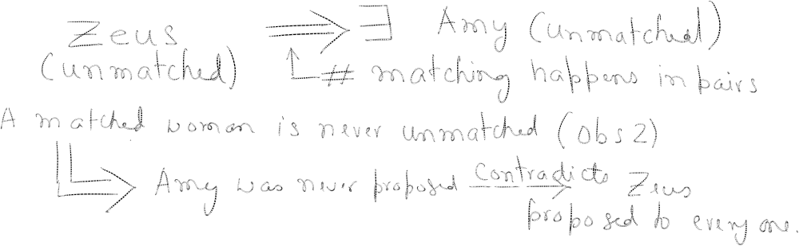
Proof of Correctness: Perfection
Claim. All men and women get matched.
Pf. (by contradiction)
  Suppose, for sake of contradiction, that Zeus is not matched upon termination of algorithm.
  Then some woman, say Amy, is not matched upon termination.
  By Observation 2, Amy was never proposed to.
  But, Zeus proposes to everyone, since he ends up unmatched. ▪

Slide 16
Proof of Correctness: Stability
Claim. No unstable pairs.
Pf. (by contradiction)
  Suppose A-Z is an unstable pair: each prefers each other to partner in Gale-Shapley matching S*.
  Case 1: Z never proposed to A.
  ⇒ Z prefers his GS partner to A.
  ⇒ A-Z is stable.
  Case 2: Z proposed to A.
  ⇒ A rejected Z (right away or later)
  ⇒ A prefers her GS partner to Z.
  ⇒ A-Z is stable.
  In either case A-Z is stable, a contradiction. ▪
men propose in decreasing
order of preference
S*
Amy-Yancey
Bertha-Zeus
. . .
women only trade up

Slide 17
Summary
Stable matching problem. Given n men and n women, and their preferences, find a stable matching if one exists.
Gale-Shapley algorithm. Guarantees to find a stable matching for any problem instance.
Q. How to implement GS algorithm efficiently?
Q. If there are multiple stable matchings, which one does GS find?

Slide 18
Efficient Implementation
Efficient implementation. We describe O(n²) time implementation.
Representing men and women.
  Assume men are named 1, …, n.
  Assume women are named 1', …, n'.
Engagements.
  Maintain a list of free men, e.g., in a queue.
  Maintain two arrays wife[m], and husband[w].
    set entry to 0 if unmatched
    if m matched to w then wife[m]=w and husband[w]=m
Men proposing.
  For each man, maintain a list of women, ordered by preference.
  Maintain an array count[m] that counts the number of proposals made by man m.
Notes:
could use stack instead of queue for list of free men

Slide 19
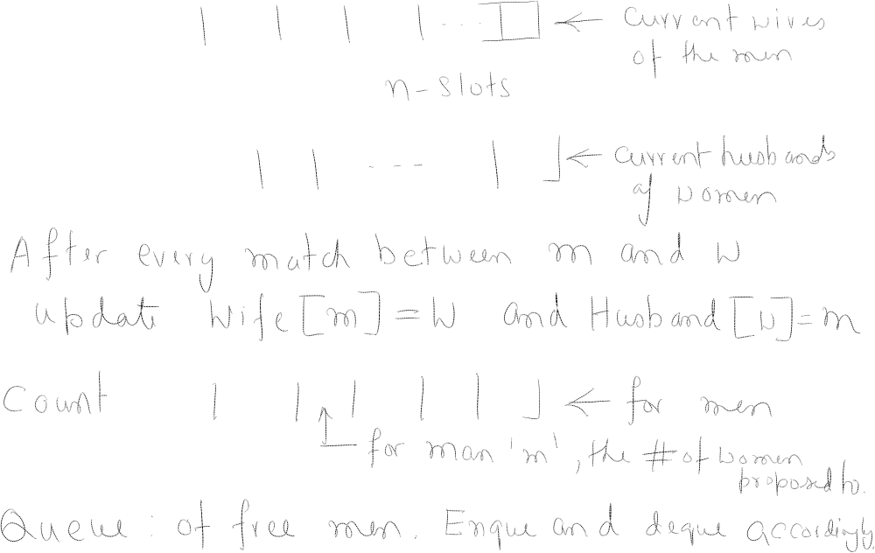






Notes:
could use stack instead of queue for list of free men

Slide 20
Efficient Implementation
Women rejecting/accepting.
  Does woman w prefer man m to man m'?
  For each woman, create an array with the rank of each man.
  Constant time access for each query after O(n) preprocessing.
Amy
1st
2nd
3rd
4th
5th
6th
7th
8th
Pref
8
3
7
1
4
5
6
2
Amy
1
2
3
4
5
6
7
8
Rank
4th
8th
2nd
5th
6th
7th
3rd
1st
Amy prefers man 3 to 6
since rank[3] < rank[6]
for i = 1 to n
rank[pref[i]] = i
2
7

Slide 21
Understanding the Solution
Q. For a given problem instance, there may be several stable matchings. Do all executions of Gale-Shapley yield the same stable matching? If so, which one?
An instance with two stable matchings.
  A-X, B-Y, C-Z.
  A-Y, B-X, C-Z.
1st
2nd
3rd
1st
2nd
3rd
Xavier
A
B
C
Amy
Y
X
Z
Yancey
B
A
C
Bertha
X
Y
Z
Zeus
A
B
C
Clare
X
Y
Z

Slide 22
Understanding the Solution
Q. For a given problem instance, there may be several stable matchings. Do all executions of Gale-Shapley yield the same stable matching? If so, which one?
Def. Man m is a valid partner of woman w if there exists some stable matching in which they are matched.
Notes:
"genre of questions that arise in many areas of cs: algorithm runs asynchronously, with different independent components performing actions that can be interleaved in complex ways, and we want to know how much variability this asynchrony can cause in final outcome (e.g., if independent components are engines on different wings of airplane, it might be a big deal)"
man-optimality: guarantees that all possible executions of Gale-Shapley (with men as proposers) yields same stable marriage
this is a remarkable result: if each man is independently given his best stable partner, then the result is a stable marriage; yet a priori there is no reason to believe that this is even a perfect matching, let alone stable!
characterize matching found - number of possible ways to prove, many lead to complicated proofs

Slide 23
Understanding the Solution
Q. For a given problem instance, there may be several stable matchings. Do all executions of Gale-Shapley yield the same stable matching? If so, which one?
Def. Man m is a valid partner of woman w if there exists some stable matching in which they are matched.
Man-optimal assignment. Each man receives best valid partner.
Notes:
"genre of questions that arise in many areas of cs: algorithm runs asynchronously, with different independent components performing actions that can be interleaved in complex ways, and we want to know how much variability this asynchrony can cause in final outcome (e.g., if independent components are engines on different wings of airplane, it might be a big deal)"
man-optimality: guarantees that all possible executions of Gale-Shapley (with men as proposers) yields same stable marriage
this is a remarkable result: if each man is independently given his best stable partner, then the result is a stable marriage; yet a priori there is no reason to believe that this is even a perfect matching, let alone stable!
characterize matching found - number of possible ways to prove, many lead to complicated proofs

Slide 24
Understanding the Solution
Q. For a given problem instance, there may be several stable matchings. Do all executions of Gale-Shapley yield the same stable matching? If so, which one?
Def. Man m is a valid partner of woman w if there exists some stable matching in which they are matched.
Man-optimal assignment. Each man receives best valid partner.
Claim. All executions of GS yield man-optimal assignment, which is a stable matching!
  No reason a priori to believe that man-optimal assignment is perfect, let alone stable.
  Simultaneously best for each and every man.
Notes:
"genre of questions that arise in many areas of cs: algorithm runs asynchronously, with different independent components performing actions that can be interleaved in complex ways, and we want to know how much variability this asynchrony can cause in final outcome (e.g., if independent components are engines on different wings of airplane, it might be a big deal)"
man-optimality: guarantees that all possible executions of Gale-Shapley (with men as proposers) yields same stable marriage
this is a remarkable result: if each man is independently given his best stable partner, then the result is a stable marriage; yet a priori there is no reason to believe that this is even a perfect matching, let alone stable!
characterize matching found - number of possible ways to prove, many lead to complicated proofs

Slide 25

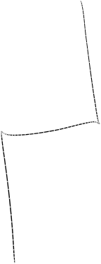
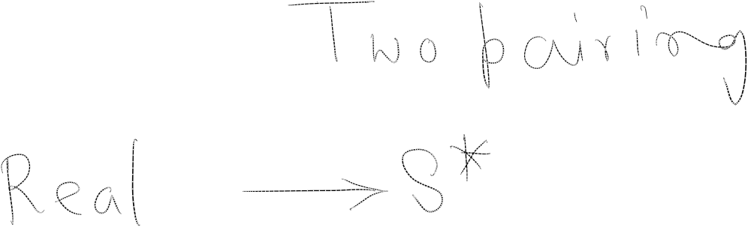
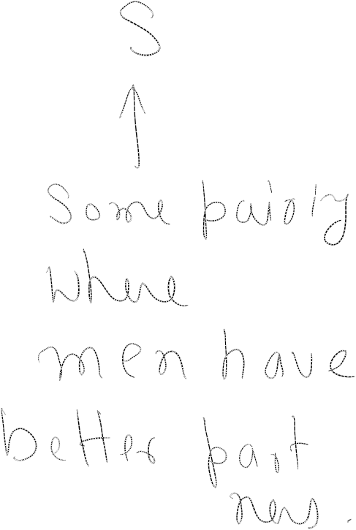
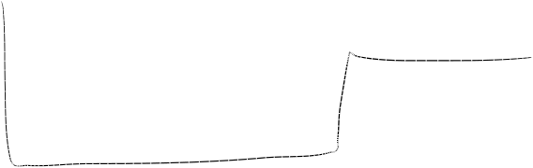



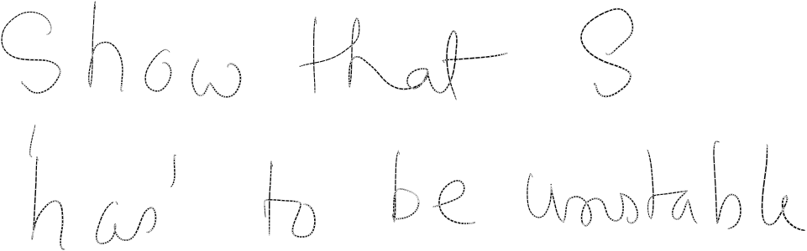

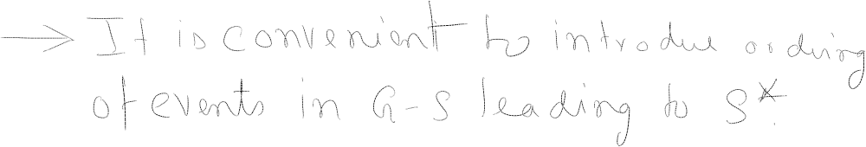

Slide 26
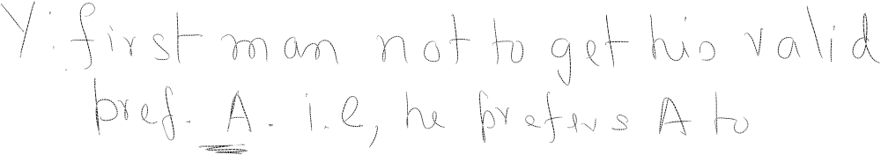



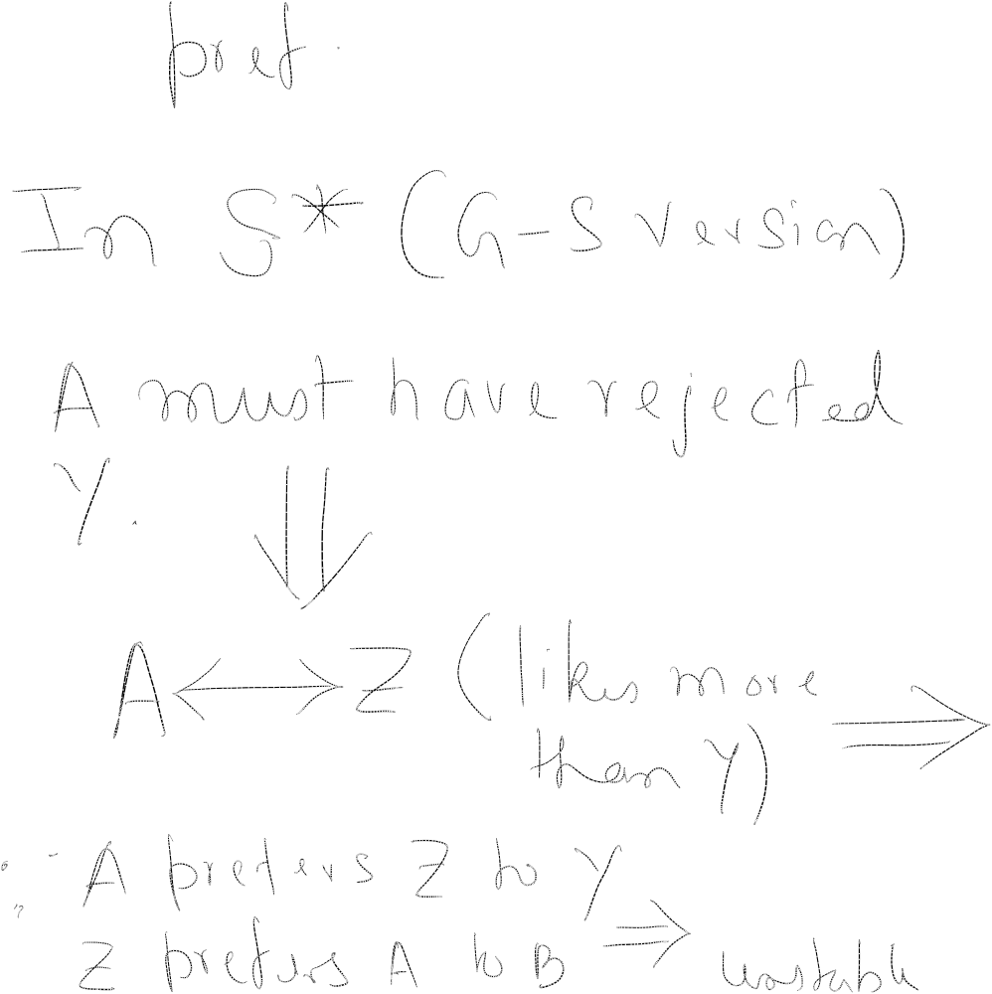

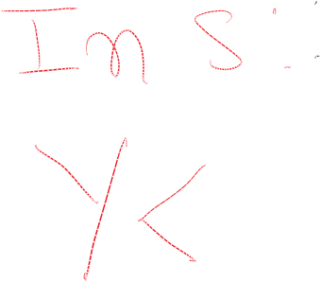
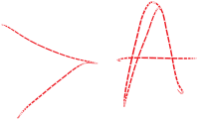
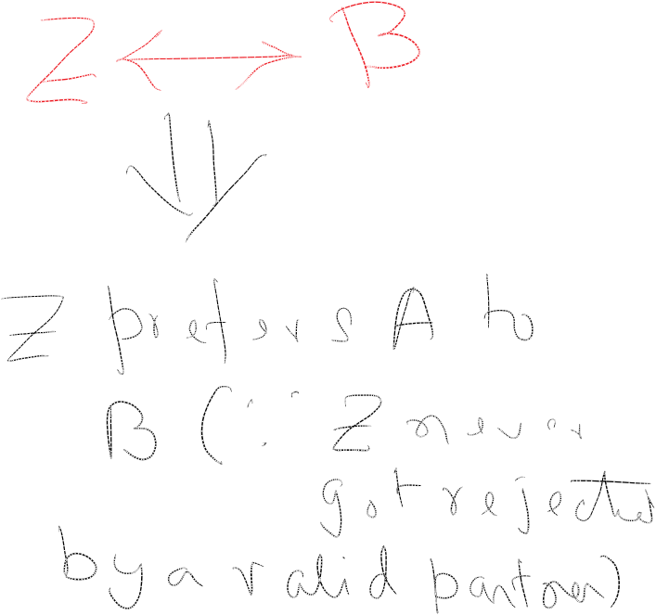


Slide 27
Man Optimality
Claim. GS matching S* is man-optimal.
Pf. (by contradiction)
  Suppose some man is paired with someone other than best partner. Men propose in decreasing order of preference ⇒ some man is rejected by valid partner.
  Let Y be first such man, and let A be first valid
  woman that rejects him.
  Let S be a stable matching where A and Y are matched.
  When Y is rejected, A forms (or reaffirms)
  engagement with a man, say Z, whom she prefers to Y.
  Let B be Z's partner in S.
  Z not rejected by any valid partner at the point when Y is rejected by A. Thus, Z prefers A to B.
  But A prefers Z to Y.
  Thus A-Z is unstable in S. ▪
S
Yancey-Amy
Zeus-Bertha
. . .
since this is first rejection
by a valid partner

Slide 28
Stable Matching Summary
Stable matching problem. Given preference profiles of n men and n women, find a stable matching.
Gale-Shapley algorithm. Finds a stable matching in O(n²) time.
Man-optimality. In version of GS where men propose, each man receives best valid partner.
Q. Does man-optimality come at the expense of the women?
no man and woman prefer to be with
each other than assigned partner
w is a valid partner of m if there exist some
stable matching where m and w are paired

Slide 29
Woman Pessimality
Woman-pessimal assignment. Each woman receives worst valid partner.
Claim. GS finds woman-pessimal stable matching S*.
Pf.
  Suppose A-Z matched in S*, but Z is not worst valid partner for A.
  There exists stable matching S in which A is paired with a man, say Y, whom she likes less than Z.
  Let B be Z's partner in S.
  Z prefers A to B.
  Thus, A-Z is an unstable in S. ▪
S
man-optimality
Amy-Yancey
Bertha-Zeus
. . .

Slide 30
Extensions: Matching Residents to Hospitals
Ex: Men ≈ hospitals, Women ≈ med school residents.
Variant 1. Some participants declare others as unacceptable.
Variant 2. Unequal number of men and women.
Variant 3. Limited polygamy.
Def. Matching S unstable if there is a hospital h and resident r such that:
  h and r are acceptable to each other; and
  either r is unmatched, or r prefers h to her assigned hospital; and
  either h does not have all its places filled, or h prefers r to at least one of its assigned residents.
resident A unwilling to
work in Cleveland
hospital X wants to hire 3 residents

Slide 31
Application: Matching Residents to Hospitals
NRMP. (National Resident Matching Program)
  Original use just after WWII.
  Ides of March, 23,000+ residents.
Rural hospital dilemma.
  Certain hospitals (mainly in rural areas) were unpopular and declared unacceptable by many residents.
  Rural hospitals were under-subscribed in NRMP matching.
  How can we find stable matching that benefits "rural hospitals"?
Rural Hospital Theorem (1986). Any hospital that has some empty positions at some stable matching is assigned precisely the same set of residents at every stable matching.
predates computer usage
Notes:
Resident = graduating medical student
Matching law clerks to Federal judges currently use ad hoc system. Intense competition and duplicity for law clerks. Will history repeat itself?
Fulbright senior scholars awards program matches American scholars with foreign universities

Slide 32
1.2 Five Representative Problems

Slide 33
Interval Scheduling
Input. Set of jobs with start times and finish times.
Goal. Find maximum cardinality subset of mutually compatible jobs.
jobs don't overlap
a
b
b
c
d
e
e
f
g
h
h
Time
0
1
2
3
4
5
6
7
8
9
10
11
Notes:
Activity selection = interval scheduling
OPT = B, E, H
Note: smallest job (C) is not in any optimal solution, job that starts first (A) is not in any optimal solution.

Slide 34
Weighted Interval Scheduling
Input. Set of jobs with start times, finish times, and weights.
Goal. Find maximum weight subset of mutually compatible jobs.
23
12
20
26
13
20
11
16
Time
0
1
2
3
4
5
6
7
8
9
10
11

Slide 35
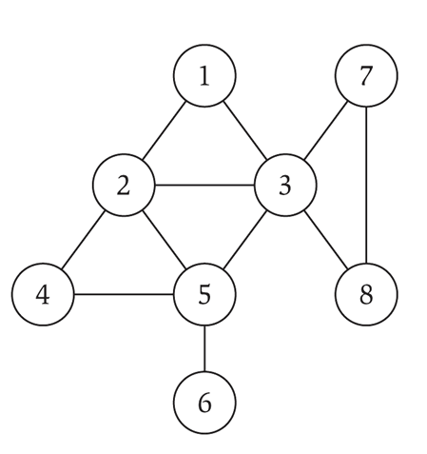
Undirected Graphs
Undirected graph. G = (V, E)
  V = nodes.
  E = edges between pairs of nodes.
  Captures pairwise relationship between objects.
  Graph size parameters: n = |V|, m = |E|.
V = { 1, 2, 3, 4, 5, 6, 7, 8 }
E = { 1-2, 1-3, 2-3, 2-4, 2-5, 3-5, 3-7, 3-8, 4-5, 5-6 }
n = 8
m = 11

Slide 36
Some Graph Applications
Graph
Nodes
Edges
transportation
street intersections
highways
communication
computers
fiber optic cables
World Wide Web
web pages
hyperlinks
social
people
relationships
food web
species
predator-prey
software systems
functions
function calls
scheduling
tasks
precedence constraints
circuits
gates
wires

Slide 37
World Wide Web
Web graph.
  Node: web page.
  Edge: hyperlink from one page to another.
cnn.com
netscape.com
novell.com
cnnsi.com
timewarner.com
hbo.com
sorpranos.com

Slide 38
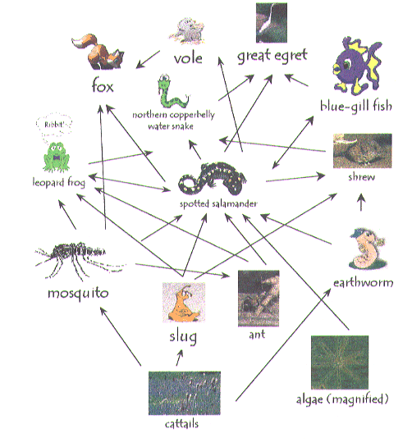
Ecological Food Web
Food web graph.
  Node = species.
  Edge = from prey to predator.
Reference: http://www.twingroves.district96.k12.il.us/Wetlands/Salamander/SalGraphics/salfoodweb.giff

Slide 39
Bipartite Matching
Input. Bipartite graph.
Goal. Find maximum cardinality matching.
A
1
B
2
C
3
D
4
E
5

Slide 40
Independent Set
Input. Graph.
Goal. Find maximum cardinality independent set.
subset of nodes such that no two
joined by an edge
1
2
1
4
5
4
5
3
6
7
6

Slide 41
Competitive Facility Location
Input. Graph with weight on each each node.
Game. Two competing players alternate in selecting nodes. Not allowed to select a node if any of its neighbors have been selected.
Goal. Select a maximum weight subset of nodes.
10
1
5
15
5
1
5
1
15
10
Second player can guarantee 20, but not 25.
Notes:
subset of selected nodes must form an independent set

Slide 42
Five Representative Problems
Variations on a theme: independent set.
Interval scheduling: n log n greedy algorithm.
Weighted interval scheduling: n log n dynamic programming algorithm.
Bipartite matching: n^{k} max-flow based algorithm.
Independent set: NP-complete.
Competitive facility location: PSPACE-complete.

Slide 43
Review Questions
Based on slides by Sofya Raskhodnikova

Slide 44
Review Questions
Brute force algorithm: an algorithm that checks every possible solution.
In terms of n, what is the running time of the brute force algorithm for Stable Matching Problem? (Assume your algorithm goes over all possible perfect matchings.)
(Answer: n! × (time to check if a matching is stable) = Θ(n! n²) )

Slide 45
Review Questions
How many stable matchings are there for this instance?
0
1
2 or more.
Men’s preferences
Women’s preferences
1st
2nd
3rd
4th
5th
1st
2nd
3rd
4th
5th
Victor
B
A
D
E
C
Amy
Z
V
W
Y
X
Wyatt
D
B
A
C
E
Bertha
X
W
Y
V
Z
Xavier
B
E
C
D
A
Clare
W
X
Y
Z
V
Yancey
A
D
C
B
E
Diane
V
Z
Y
X
W
Zeus
B
D
A
E
C
Erika
Y
W
Z
X
V

Slide 46
Review Questions
1)
2)
Men’s preferences
Women’s preferences
1st
2nd
3rd
4th
5th
1st
2nd
3rd
4th
5th
Victor
B
A
D
E
C
Amy
Z
V
W
Y
X
Wyatt
D
B
A
C
E
Bertha
X
W
Y
V
Z
Xavier
B
E
C
D
A
Clare
W
X
Y
Z
V
Yancey
A
D
C
B
E
Diane
V
Z
Y
X
W
Zeus
B
D
A
E
C
Erika
Y
W
Z
X
V
Men’s preferences
Women’s preferences
1st
2nd
3rd
4th
5th
1st
2nd
3rd
4th
5th
Victor
B
A
D
E
C
Amy
Z
V
W
Y
X
Wyatt
D
B
A
C
E
Bertha
X
W
Y
V
Z
Xavier
B
E
C
D
A
Clare
W
X
Y
Z
V
Yancey
A
D
C
B
E
Diane
V
Z
Y
X
W
Zeus
B
D
A
E
C
Erika
Y
W
Z
X
V

